Slide 1

Customer Shopping Behavior Analysis
Uncovering insights from 3,900 purchases to guide strategic decisions

Slide 2
DATASET OVERVIEW
The Foundation
3.9K
18
50
Total Purchases
Data Points
Locations
Transactions analyzed
Features per customer
Geographic coverage
Key Features Tracked
Customer demographics & subscription status
Purchase details & product categories
Shopping behavior & review ratings
Shipping preferences & payment methods

Slide 3

PYTHON ANALYSIS
Data Preparation Journey
Load Data
Clean & Standardize
Handle Missing Values
Engineer Features
Transformed raw data into analysis-ready format through systematic cleaning and feature engineering

Slide 4

Revenue Insights
Gender Split
Smart Spenders
Shipping Impact
Male customers: $157K
839 customers used discounts but spent above average
Express: $60.48 avg
Female customers: $75K
Standard: $58.46 avg

Slide 5

Top Performers
Highest Rated Products
01
Gloves
3.86 average rating
02
Sandals
3.84 average rating
03
Boots
3.82 average rating
04
Hat
3.80 average rating
05
Skirt
3.78 average rating

Slide 6
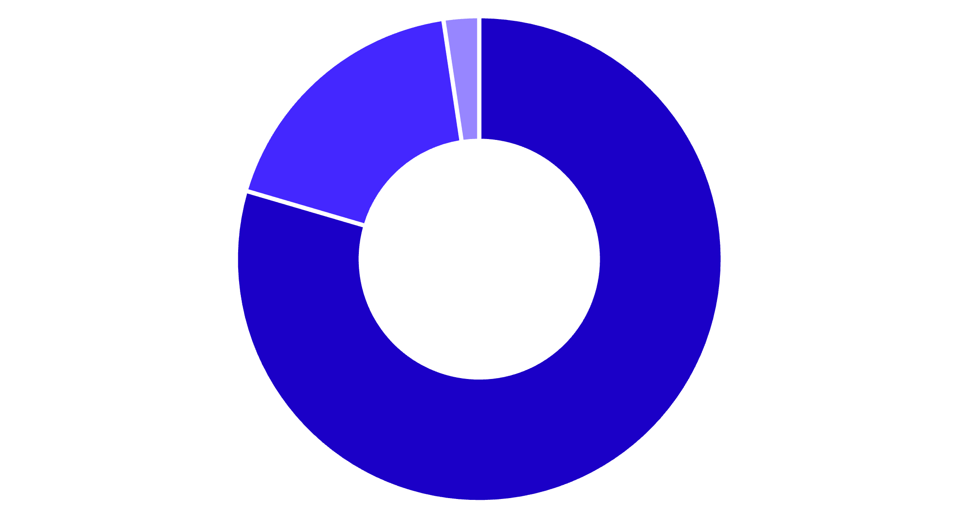


Customer Segmentation
Loyal
Returning
New
Customer Base Breakdown
80% of customers are loyal repeat buyers, showing strong retention
27%
73%
Subscription rate
Non-subscribers

Slide 7



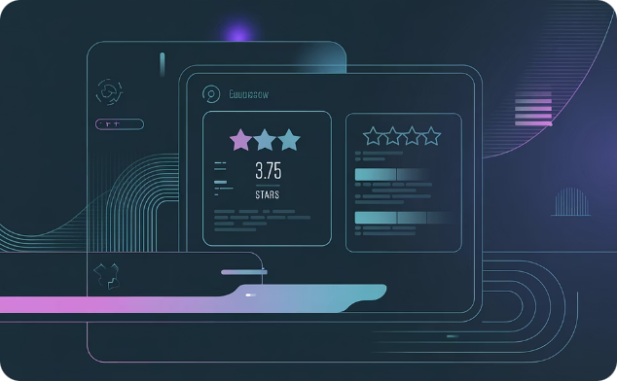
POWER BI DASHBOARD
Visual Intelligence
Category Leaders
Age Group Power
Quality Score
Clothing dominates with $100K revenue and 1,800 sales
Young Adults lead with $45K revenue contribution
3.75 average review rating across all products

Slide 8
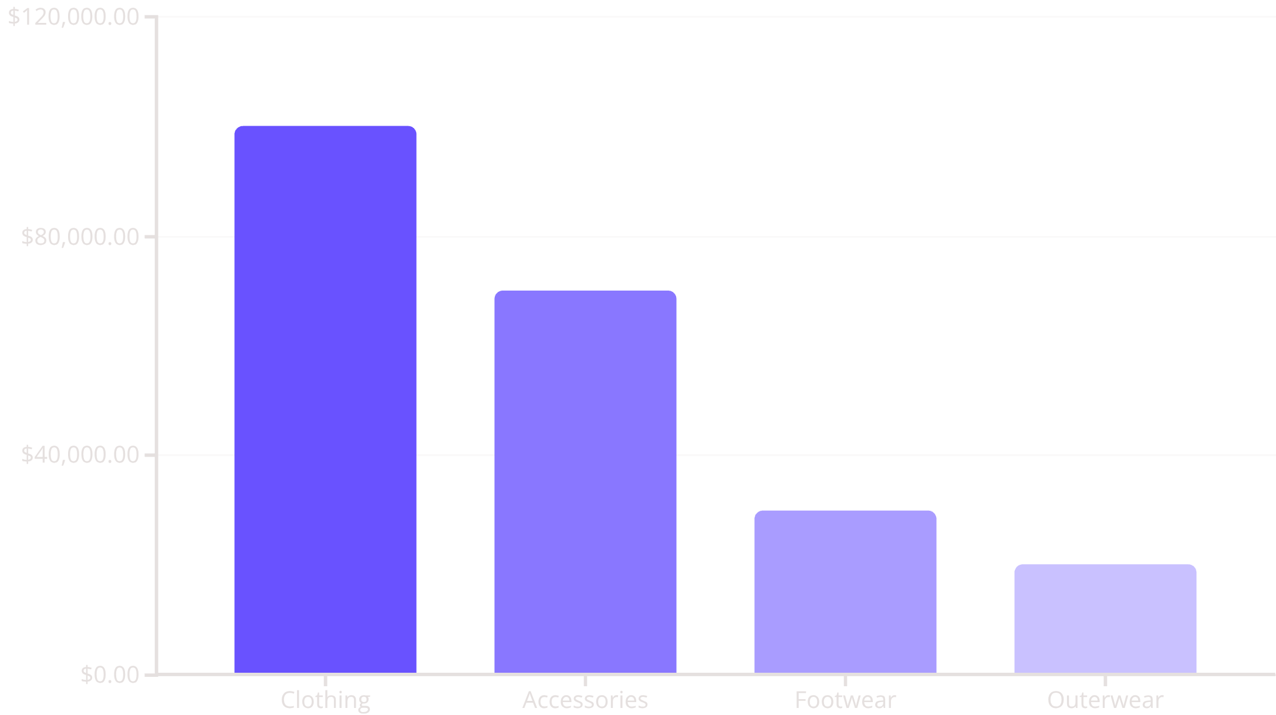
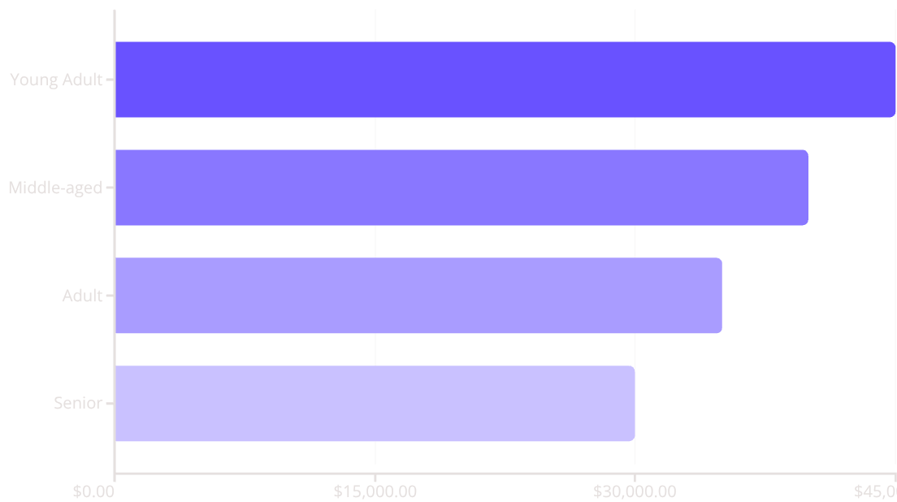
Revenue by Category & Age

Slide 9
Strategic Recommendations
1
2
3
4
Boost Subscriptions
Loyalty Programs
Review Discounts
Product Positioning
Reward repeat buyers to strengthen 80% loyal base
Balance sales boosts with margin control
Promote exclusive benefits to convert 73% non-subscribers
Highlight top-rated items in marketing campaigns
5
Targeted Marketing
Focus on Young Adults and express-shipping users

